Slide 2
Did you ever want to be a hero?

Slide 3
Did you ever want to be a hero?

Slide 4
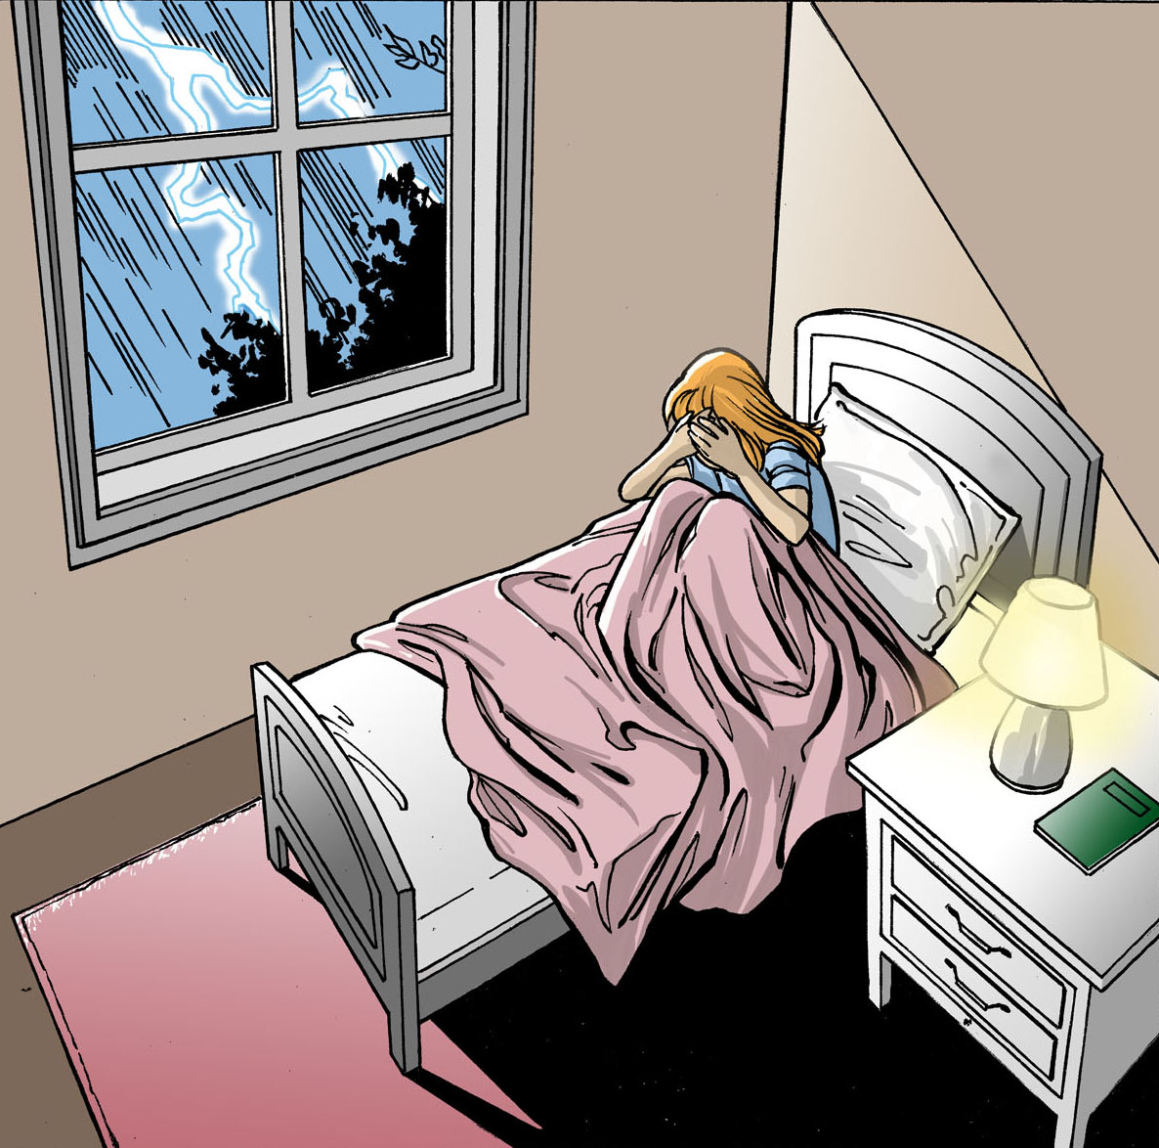

Slide 5
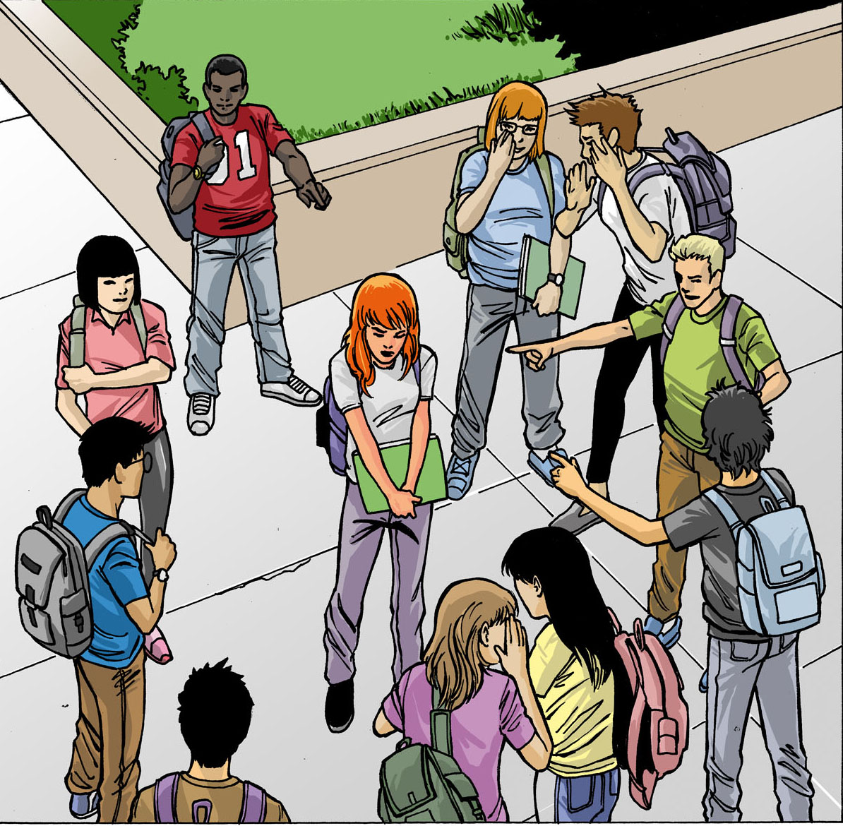

Slide 6
Notes:
The X-Men are a group of mutants that all have some special abilities, like being able to walk through walls or read people’s minds or having superstrength. Sounds pretty cool, right? Well, not many of them felt that way.

Slide 7
“What I wouldn’t give to be normal” Mystique and Beast (First Class)

Slide 8
Posttraumatic growth

Slide 9
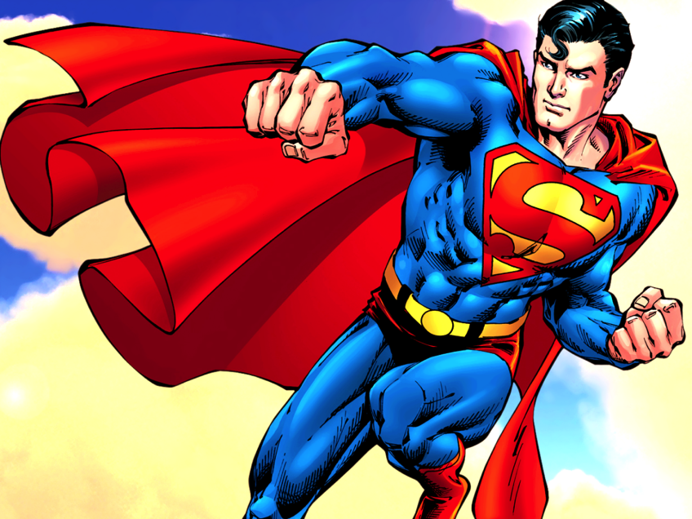
Superman: clinical application
“I wanted to be Superman… I failed”

Slide 10
Superman: clinical application
“I wanted to be Superman, I failed”
Invincible

Slide 11
Superman: clinical application
“I wanted to be Superman, I failed”
Invincible
Kryptonite

Slide 12
What is Superhero Therapy?
Using popular culture (books, TV shows, movies, and video games examples in research-supported therapies)

Slide 13
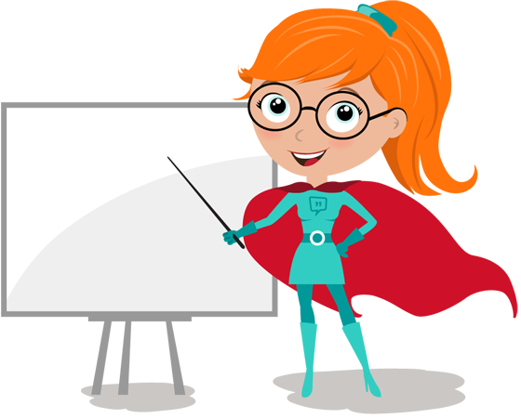
Most important rule of Superhero Therapy
You don’t have to be the expert
The client is the expert

Slide 14
Ant-Man example

Slide 15
Why Superhero Therapy?
During most difficult time, people feel alone
Shame

Slide 16
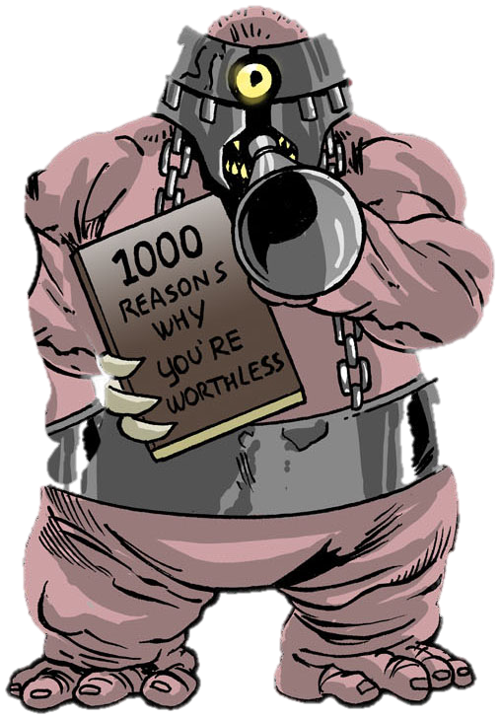
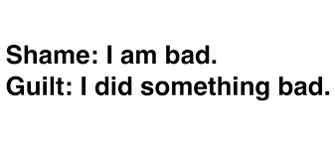

Slide 17
Brené Brown’s Research
“We deny our loneliness. We feel shame around being lonely even when it’s caused by grief, loss, or heartbreak”
– Brené Brown
We all have shame
We’re afraid to talk about shame
The less we talk about it, the more we have it

Slide 18
What people shame themselves about

Slide 19
What people shame themselves about
Appearance/body image

Slide 20
What people shame themselves about
Appearance/body image
Money

Slide 21
What people shame themselves about
Appearance/body image
Money
Mental health

Slide 22
What people shame themselves about
Appearance/body image
Money
Mental health
Physical health

Slide 23
What people shame themselves about
Appearance/body image
Money
Mental health
Physical health
Addiction

Slide 24
What people shame themselves about
Appearance/body image
Money
Mental health
Physical health
Addiction
Sex

Slide 25
What people shame themselves about
Appearance/body image
Money
Mental health
Physical health
Addiction
Sex
Religion

Slide 26
What people shame themselves about
Appearance/body image
Money
Mental health
Physical health
Addiction
Sex
Religion
Surviving/experiencing trauma

Slide 27
What people shame themselves about
Appearance/body image
Money
Mental health
Physical health
Addiction
Sex
Aging
Religion
Surviving/experiencing trauma
Accidents

Slide 28
What people shame themselves about
Appearance/body image
Money
Mental health
Physical health
Addiction
Sex
Religion
Surviving/experiencing trauma
Accidents
Being hungry/angry/overwhelmed/tired

Slide 29
How shame shows up in mental health

Slide 30
“Loneliness is an epidemic” -Scientific American

Slide 31
Effects of Shame/Alienation
Avoidance of core values (e.g., heroic actions)
Leading to more depression, substance use, and other symptoms

Slide 32
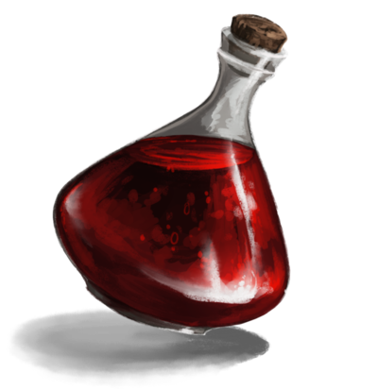
Social Connection
Getting connected with people and meaningful activities helps restore functioning
“It’s not that misery loves company, it’s that company is the antidote to misery”
- Kristin Neff

Slide 33
RESEARCH

Slide 34
Friendships & Fandoms

Slide 35
Healthier food choices
Wansink et al. (2012) from Cornell University
Children were asked to pick between apples and French fries
Only 9% chose apples
When primed with admirable heroes, like Batman, nearly 50% chose apples
Wearing Batman suit keep attention longer

Slide 36
Sexual assault awareness for children
Marvel and National Committee for Prevention of Child Abuse (NCPCA)( 1984 and 1985 )
Spider-Man discovers that a little boy was sexually abused by his babysitter
Spider-Man shares with him his own story of being sexually abused by a young man
Boy is later able to report the incident to his parents with Spider-Man’s help
Notes:
In 1984 and 1985 Marvel released two comics about Spider-Man, commissioned by the National Committee for Prevention of Child Abuse (NCPCA), who discovers that a little boy was sexually abused by his teenage babysitter and shares with him his own story of being sexually abused by a young man he became friends with. He is later able to tell his aunt and uncle about this. The boy is later able to report the incident to his parents with Spider-Man’s help. In another story, a little girl runs away because she was sexually abused by her father and her mother refuses to believe her. The girl later becomes a part of the Power Pack Kids in the later Power Pack Kids comics. In late 1980s over 16 million copies were distributed throughout the US.
In a research study, 73 children from grades 2-6 were shown the comic. Most reported being anxious afterward, realizing that it could happen to them too. One of the boys reported that the comics depicted exactly what he experienced in terms of being molested by a teenage neighbor. The boy reported that having had the comic earlier would have helped him understand that he had the right to tell his mother about the abuse and would have given him the courage to do so.

Slide 37
Research: HP boosts compassion
Notes:
HP: story of wizard boy… some wizards aren’t so nice, like Draco Malfoy here, who is calling another student a Mudblood, which means “dirty blood.” This is a derogatory word toward witches and wizards born to non-magical parents and is meant as a painful insult

Slide 38
Research: HP boosts compassion
Notes:
Vezzali et al 2014: **RTC**: researchers asked high school children to read passages from Harry Potter, either related or unrelated to prejudice, those that read the passages related to prejudice demonstrated more compassionate attitude twd stigmatized groups (LGBT, immigrants)

Slide 39
Harry Potter and Neuroimaging
Reading about Harry Potter’s struggles activated compassion and empathy centers of the brain (anterior insula and cingulate cortex) – Hsu et al., 2014
Reading Harry Potter also increased the activation in the left amygdala, related to conscious emotion processing and pleasure - Hsu et al, 2015

Slide 40
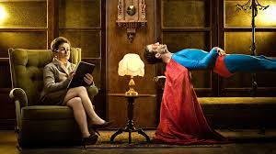
Implementing pop culture in therapy
Notes:
You don’t have to be the expert, just curious and open minded. Your client is the expert. But just to get you started, I am going to tell you about some of the examples I’ve implemented in Superhero Therapy

Slide 41
Defining your Superhero origin story

Slide 42
Your own origin story

Slide 43
Your (super)hero
Can be real life or fictional
Someone who is a figure of great strength and wisdom
What you admire about them

Slide 44
Your hero’s message

Slide 45
Hope

Slide 46
Selecting appropriate character for client
Questions to ask during evaluation session
Passions, interests, heroes
Building a treatment plan
Common humanity connection stories
Building hope
Creating exercises for recovery

Slide 47
Example
“Chuck” – 29 year old Marine w/PTSD
Physical injury
Believes himself to be “weak” and “broken”
Isolating
Withdrawing from military activities
Not spending time with family
Refusing to be in wheelchair, refusing to get a handicapped sticker

Slide 48
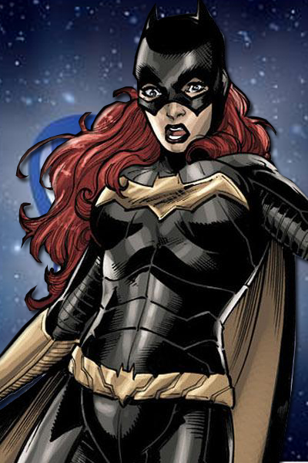
Batgirl
Notes:
Both men and women often identify with Batman’s tragic past that inspired his future path to heroism but perhaps even more inspiring is Batgirl. Batgirl’s true identity is Barbara Gordon, the daughter is Commissioner Gordon. During the height of her career as a Superhero, Batgirl was shot by Batman’s arch nemesis, the Joker.

Slide 49
Batgirl -> Oracle
Notes:
She became paralyzed from the waist down and developed PTSD. She could no longer fight crime and was scared and ashamed of her inability to be Batgirl. However, in her attempts to recover, she ends up going to see a psychologist who helps her overcome PTSD and become a new Superhero, Oracle, who can help Batman and other superheroes by tracking satellites and getting the information they need to fight crime. Even though she was injured, Batgirl doesn’t give up but continues to be a Superhero. I used Batgirl as an example when working with a disabled sailor at Camp Pendleton. He was injured in a line of duty and could no longer walk or pick up his son. His quote: “I am not the superhero dad I wanted my son to have.” Then we talked about Batgirl. I asked him, does her being Oracle now make her any less of a superhero. Of course, his answer was no. In fact, he said he’s inspired by Oracle because she didn’t give up but was unable to draw the parallels until we talked about it in therapy.

Slide 50
Creating a treatment plan
Focus on mindfulness and acceptance of condition, as well as any grief that comes with it
Cognitive restructuring/defusion practice with thoughts, such as “I’m weak, I am broken”
Explore his identity as a “hero”
Focus on core values – family, career
Set up committed actions to honor his core values

Slide 51
Small groups practice & discussion

Slide 52
Popular examples and mental health

Slide 53
Harry Potter to convey mental health

Slide 54
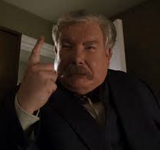
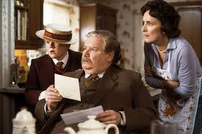
Child Abuse
Notes:
He was sent to live with his aunt and uncle, who abused him, starved him, and lied to him about his heritage. At the age of 11, A wizard named Hagrid finally tells Harry the truth.

Slide 55
Tragic losses

Slide 56
Depression

Slide 57
Pink dementor

Slide 58
Patronus

Slide 59
Chocolate

Slide 60
Phobias

Slide 61
Phobias

Slide 62
Buffy the Vampire Slayer

Slide 63
Veronica Mars EXAMPLE

Slide 64
What would Veronica do?

Slide 65
What if my client likes a villain?
Joker
Harley Quinn
Darth Vader
Voldemort

Slide 66
What is it that the client likes?
Rarely do they like that the character is a killer, so not usually an indication of homicidal ideation
Usually, an unmet need: feeling constrained by work and other obligations
Often, wanting to play more, wanting to be free, and wanting to be ok with having more fun

Slide 67
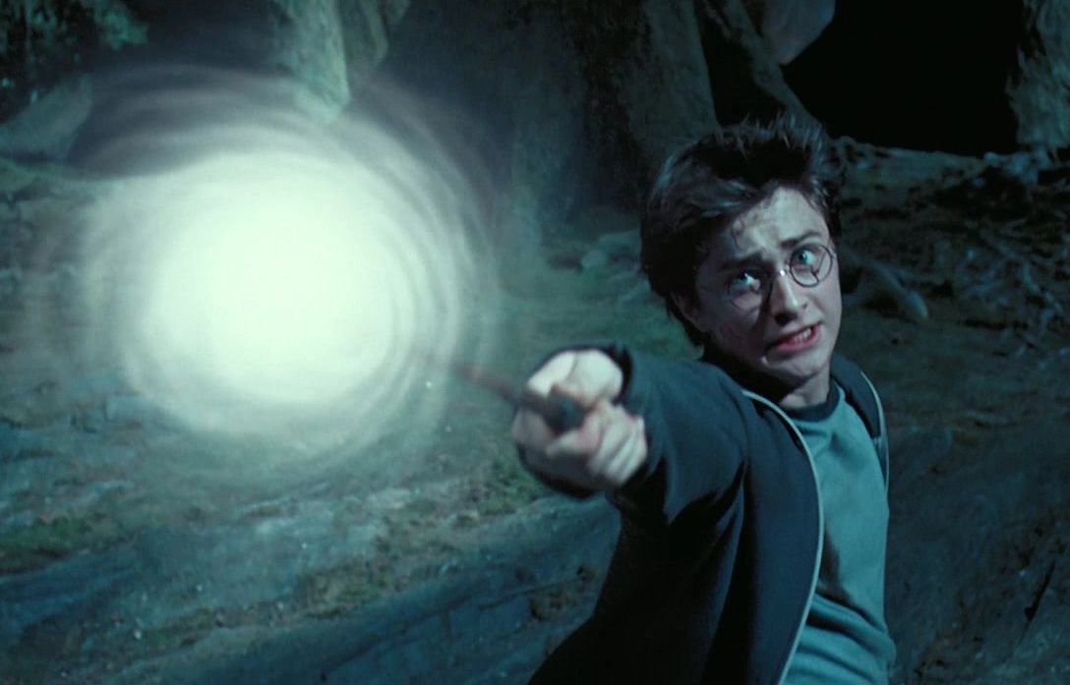
Mindfulness & acceptance
Using superheroes to identify thoughts, emotions, and internal and external experiences
Metaphors
Superhero skills
Magic spells
Jedi Practice

Slide 68
Self-Labels
“Not good enough”
“Ugly”
“Loser”
“Evil”

Slide 69
Core values
What is all of this for?
What is your quest about?

Slide 70
Committed actions & acceptance, exposures, behavioral activation
Taking action in order to fulfill your quest
Overcoming phobias like Batman
Following your heart like Wonder Woman
Standing up for what is right like Harry Potter or Luke Skywalker

Slide 71
Case Example
18 year-old female, with Panic Disorder and driving phobia
Harry Potter fan
Gryffindor
Favorite character – Ron Weasley

Slide 72
Case Example (continued)
Skills:
Mindfulness (magic potions)
Defusion (unreliable psychic)
Self-labels (“not brave enough”)
Core values (being able to connect with her friends and family)
Acceptance – willingness to do what’s necessary
Committed action – facing her fears
Driving, new places, crowds

Slide 73
Gaming
Playfulness
Value that often gets ignored
Animals play
Playfulness and health
Games and learning

Slide 74
Gamify
“The opposite of play isn’t work. It’s depression.”
-Psychologist Brian Sutton-Smith (1960s)

Slide 75
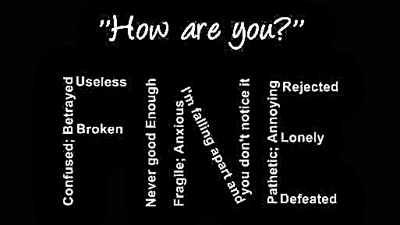
Gamify
“The opposite of play isn’t work. It’s depression.”
-Psychologist Brian Sutton-Smith (1960s)

Slide 76
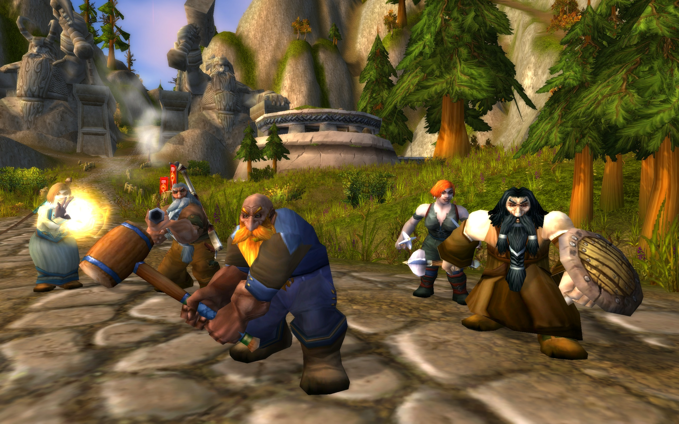
Are games a form of escapism?
Most play to “escape”
Find connection
Discover sense of purpose

Slide 77
Criticism
Face criticism from family members, educators and therapists:
“Put down the game and do something real”
“Stop wasting so much time”

Slide 78
Sutton-Smith’s research
Play Behavior
More self-confidence
More true to ourselves
Increased physical energy
More positive emotions (curiosity, optimism, excitement)

Slide 79
Types of Games
Tabletop
LARP
Computer/Video Games
Mobile App

Slide 80
Using Games in Therapy

Slide 81
Game-Based Rehabilitation for Stroke
https://www.youtube.com/watch?v=UQqisA89pAw
For OTs
How can it be applied to mental health professionals?

Slide 82
Game-Based CBT
For children who survived Childhood sexual Assault (CSA)
For kids and teens
How can it be used with adults?

Slide 83
Games in Tx (Tetris for PTSD, D&D for social skills)

Slide 84
PTSD

Slide 85
Grief

Slide 86
Superbetter

Slide 87
Games with clients
Can establish rapport and trust
Can ease client to process emotions and trauma
Can improve mood
EXAMPLE

Slide 88
Take aways
Find out about your client’s interests
Incorporate their interests into therapy
Don’t need to be the expert, just curious and open minded

Slide 89
Additional resources

Slide 91
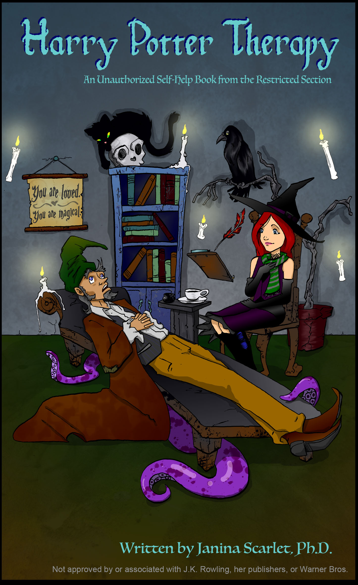

Slide 92
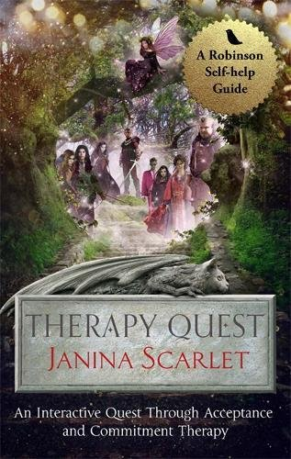

Slide 93
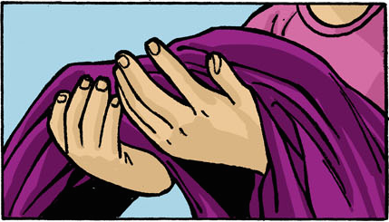
Let’s be heroes
YOU MATTER

Slide 94
Let’s be heroes
YOU MATTER
Keep Superheroing and don’t forget your cape

